Slide 1

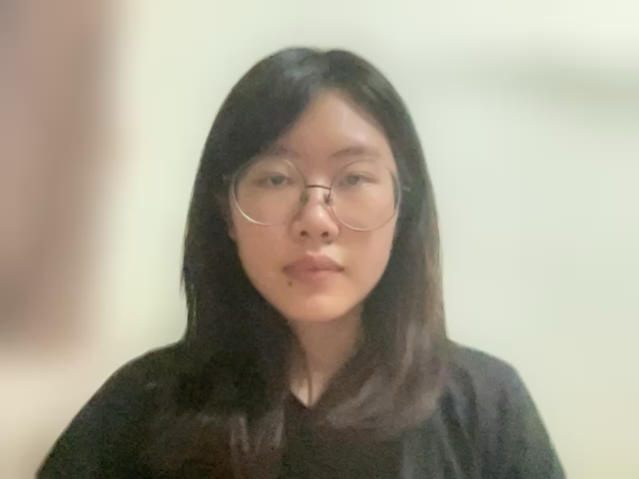
Simplex Optimization in the Production of Homemade Snacks
Group Assignment- WQD7011: Numerical Optimization
Name | Matric. No.
Kristian Surya Dinata | S2043845
Tey Yi Jie | 17081752
Ani Yeap | 17218658
Chan Jie Min | S2141167

Slide 2
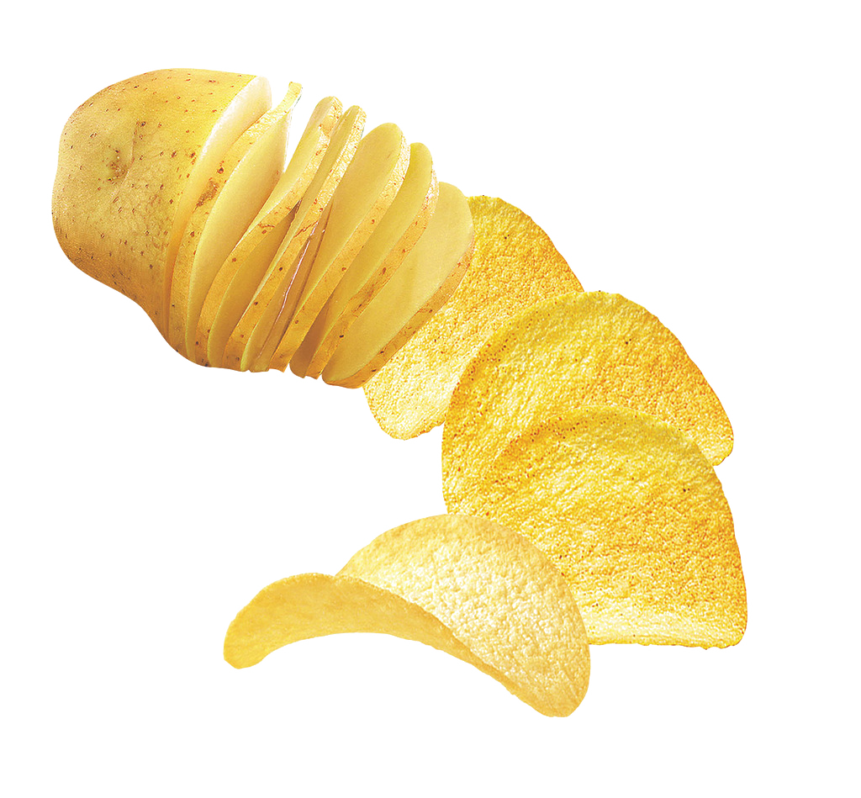
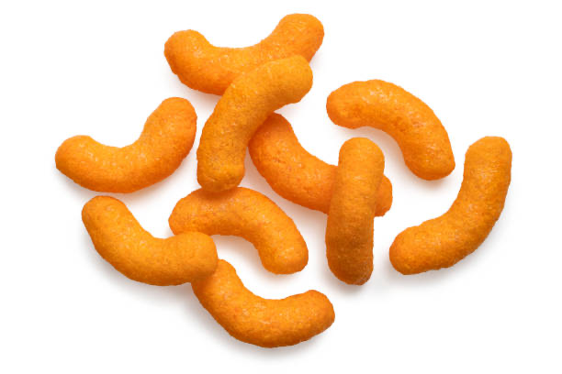
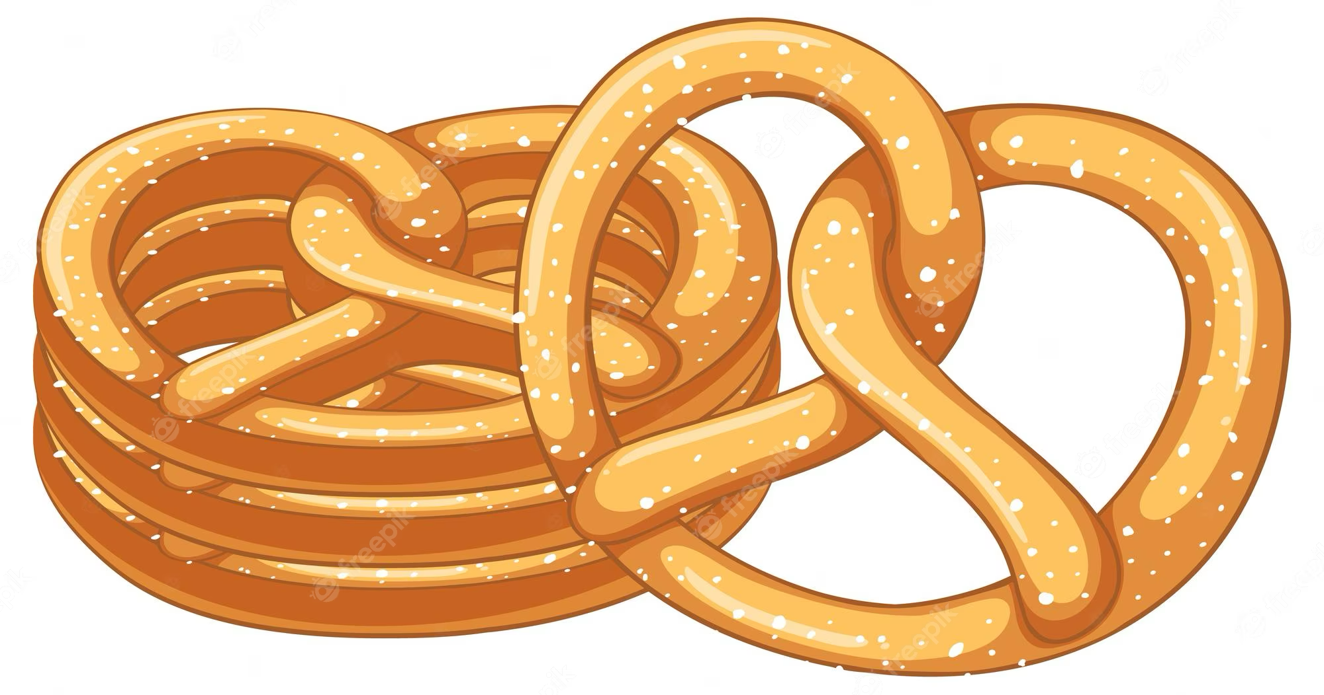
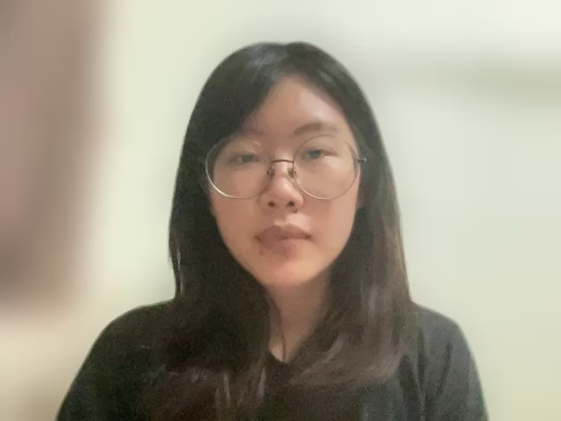
Problem Statement
A business currently produces and sells three types of homemade snacks:
Given their existing resources, they wonder what quantity they should produce of each product to maximize profits.
Cheese Puffs
Potato Chips
Pretzels
RM5
RM7
RM6

Slide 3
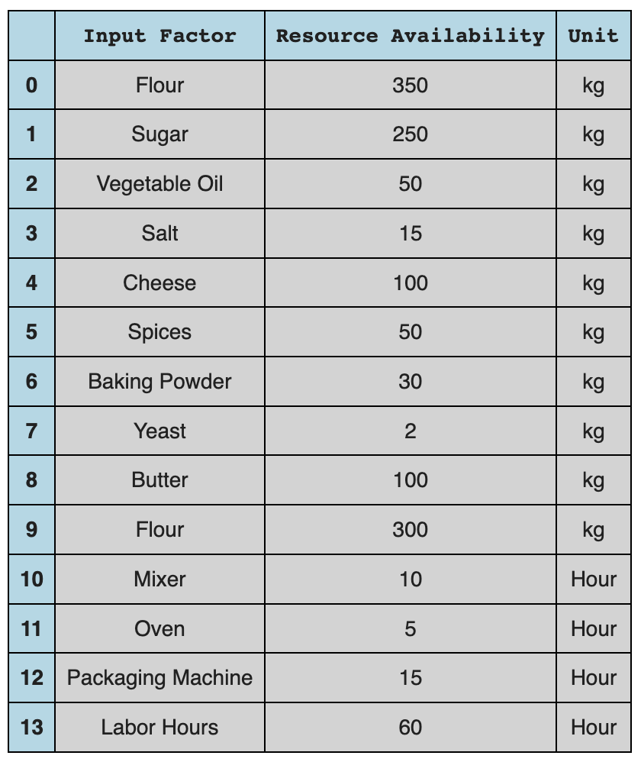
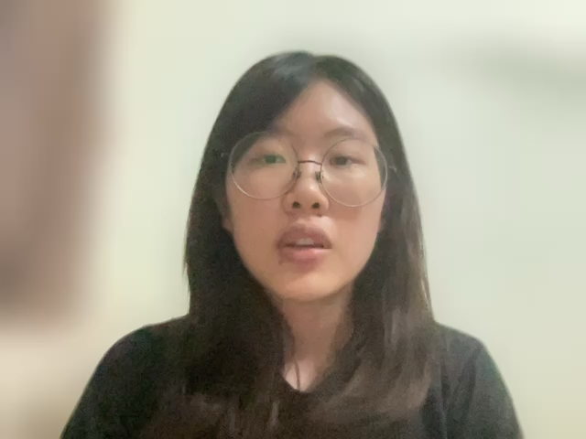
Existing Resources
These are all the available resources that the business has. `
Additionally, the business has also found that to be profitable, they must produce a minimum quantity for each of their products:
Products | Minimum Qty (packs)
Cheese Puffs | 800
Potato Chips | 350
Pretzels | 250

Slide 4
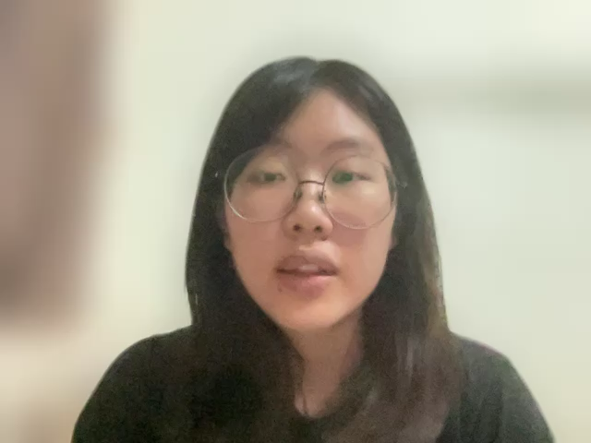
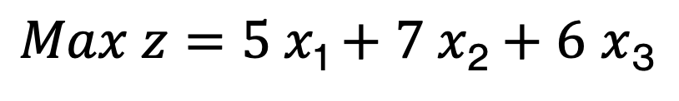
Objective Function
Using the Simplex method of optimization, the following objective function to maximize profit is formed:
Price
Maximize profit
$Max z=5 x\text{1}+7 x\text{2}+6$ $x$₃
Quantity of each snack

Slide 5
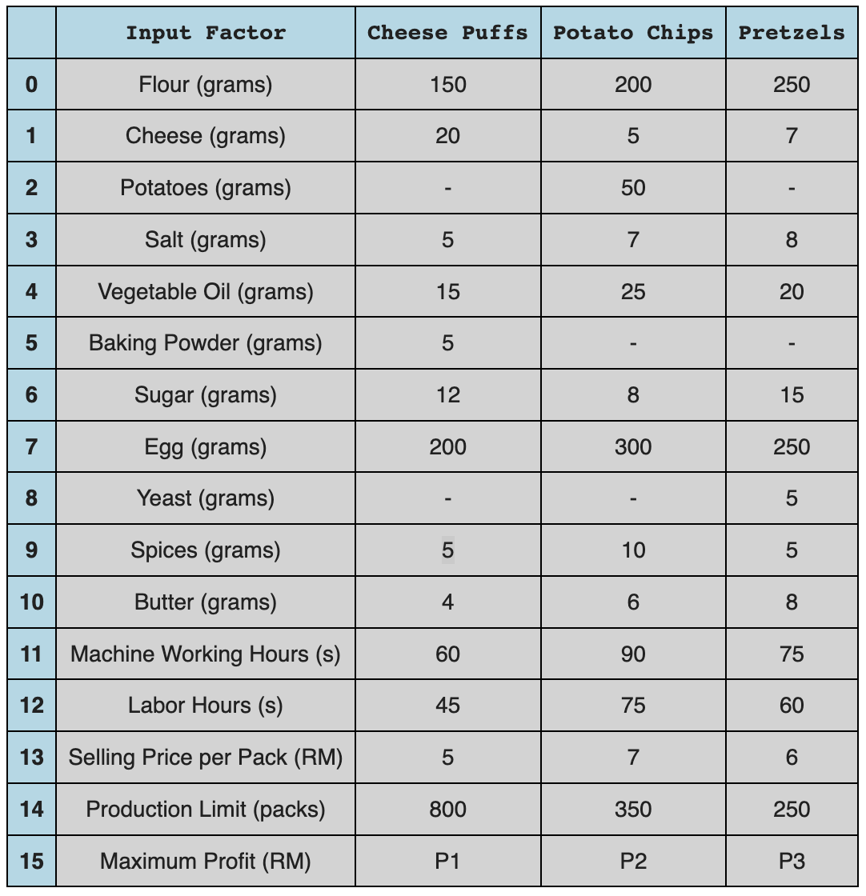
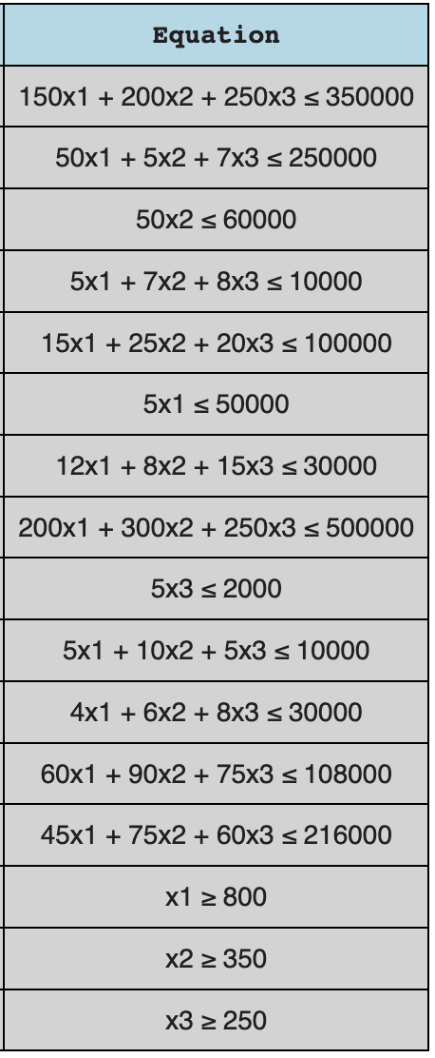
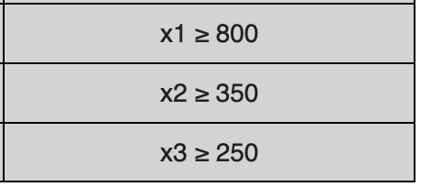
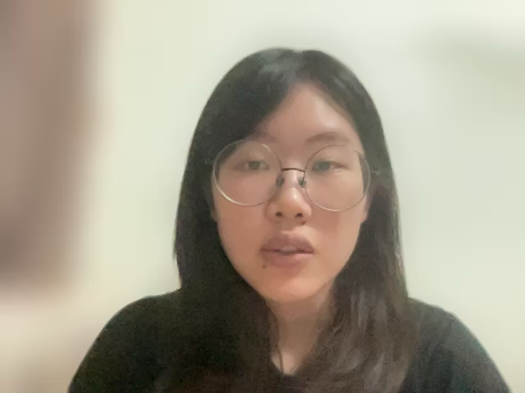
Constraint Equations
These are the resources needed to produce each snack. These represent the constraint equations.
50
Also, here are the constraints for
minimum production quantity
of the snacks.
Total = 16 constraints

Slide 6
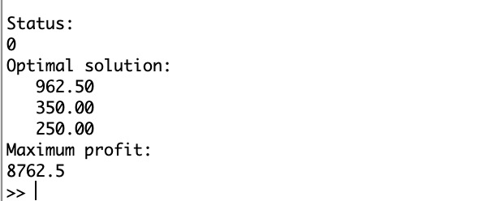
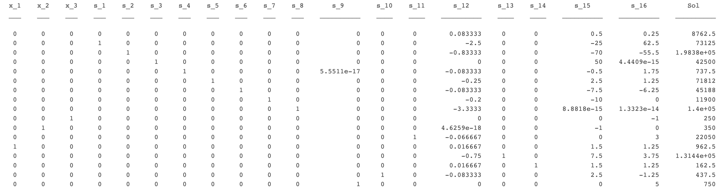
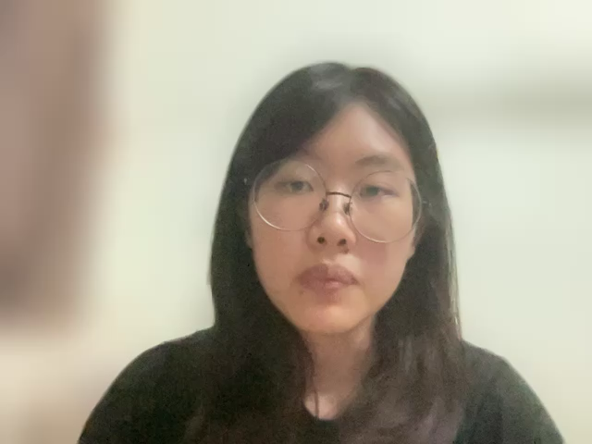
Simplex Optimization
Octave
MATLAB
Python

Slide 7
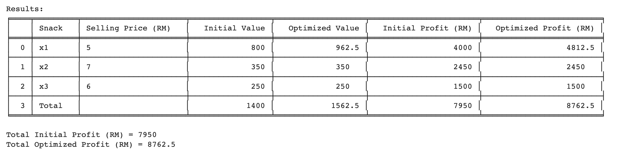
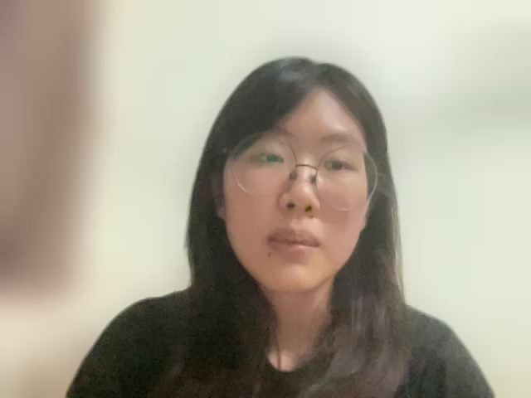
Results
Python

